Slide 1




Learning Volumetric Segmentation for Lung Tumor
Jhih-Yuan Lin, Min-Sheng Wu, Yu-Cheng Chang,
Yun-Chun Chen, Chao-Te Chou, Chun-Ting Wu, Winston H. Hsu
National Taiwan University, Taiwan
Oct. 7, 2018

Slide 2
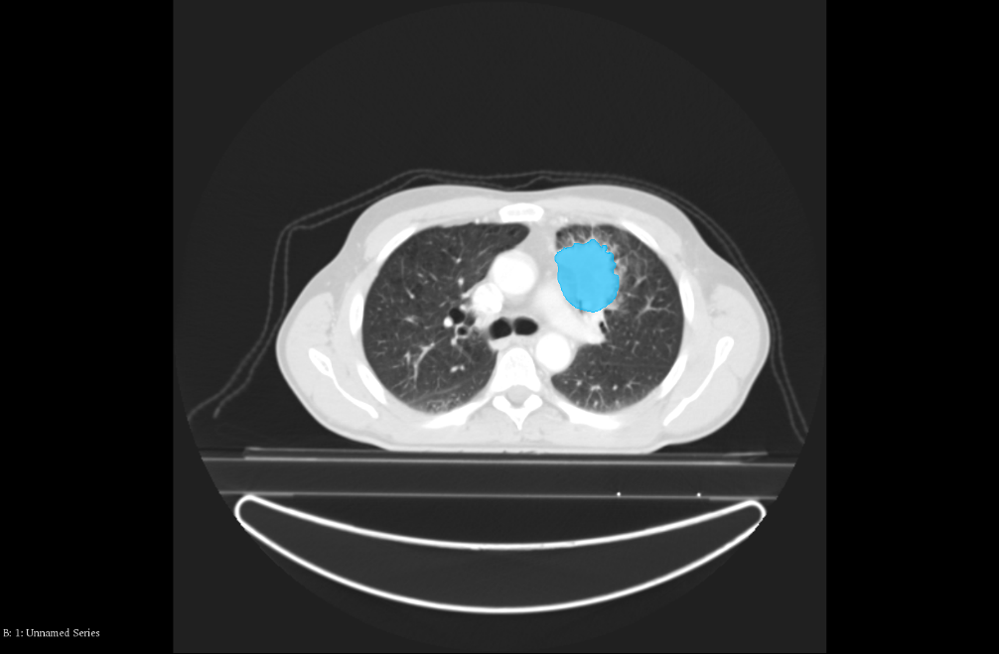
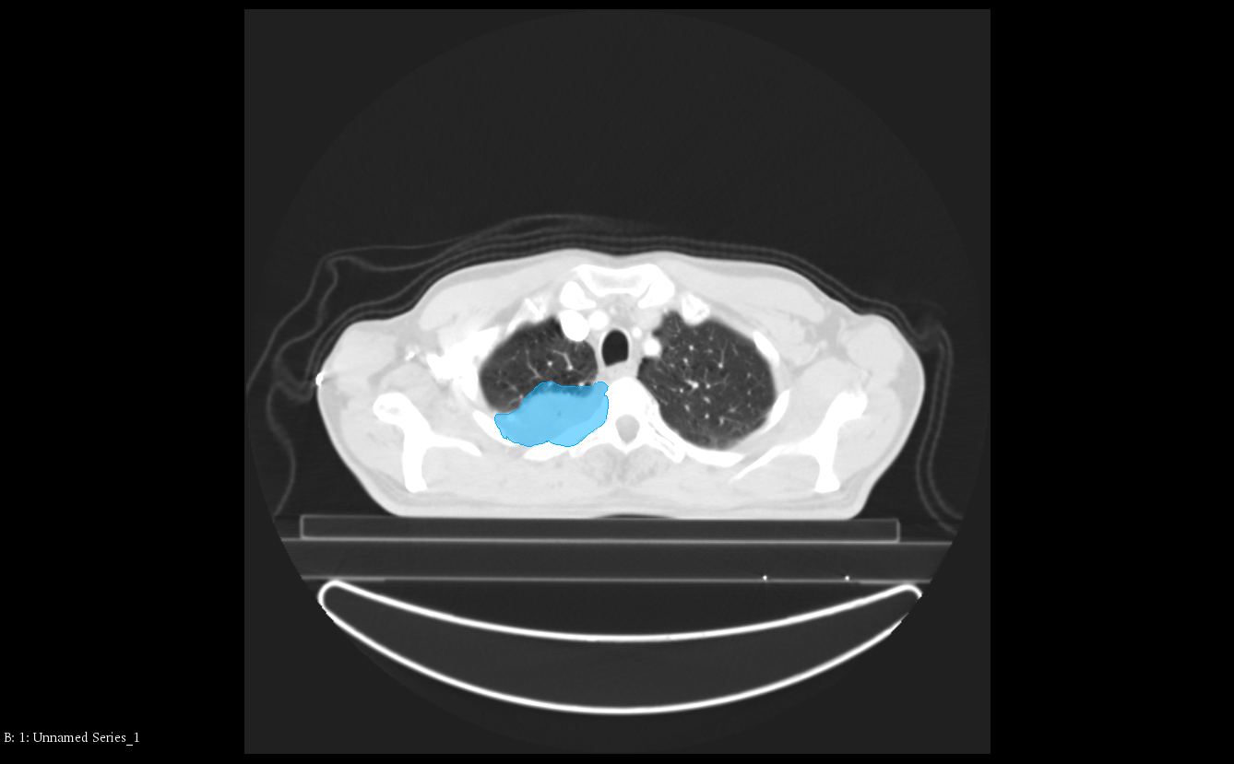
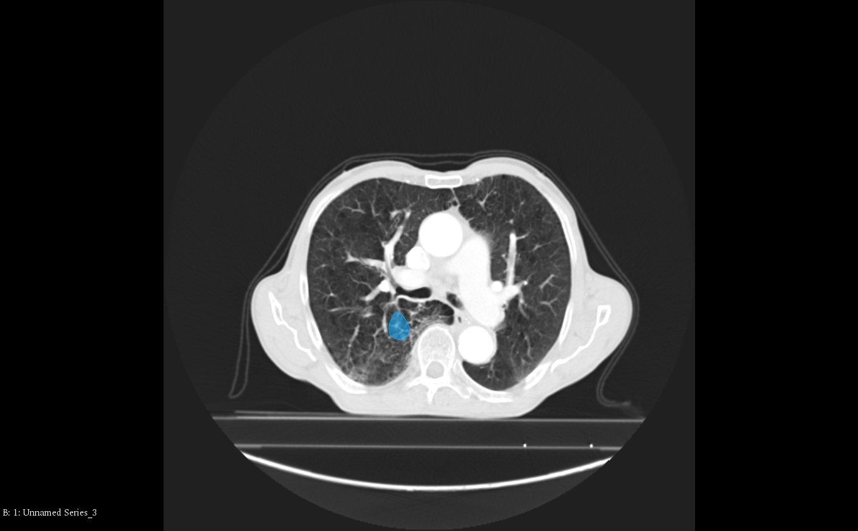
Tumor Segmentation for CT Images

Slide 3
Challenges

Slide 4
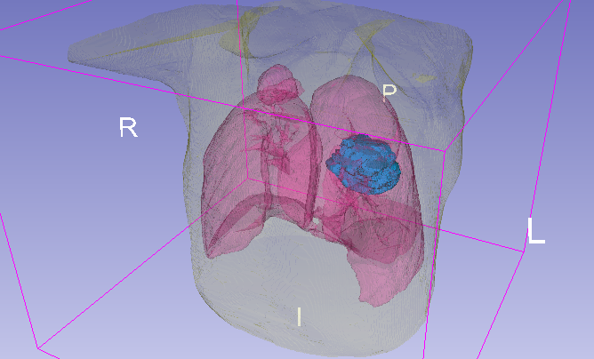
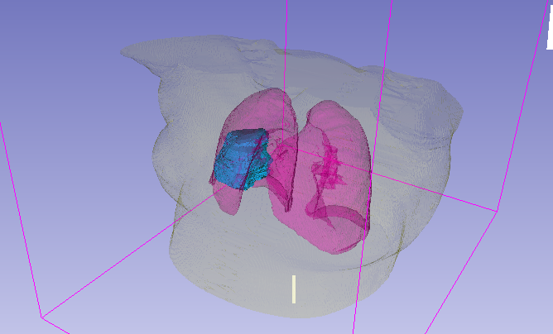
Position Variations

Slide 5
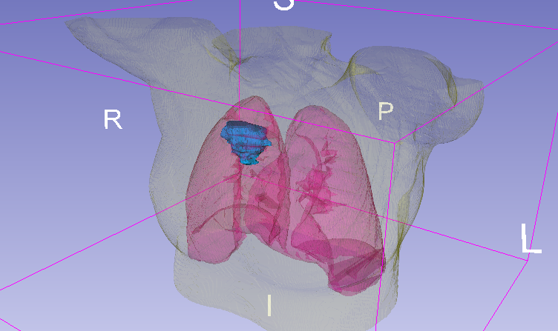
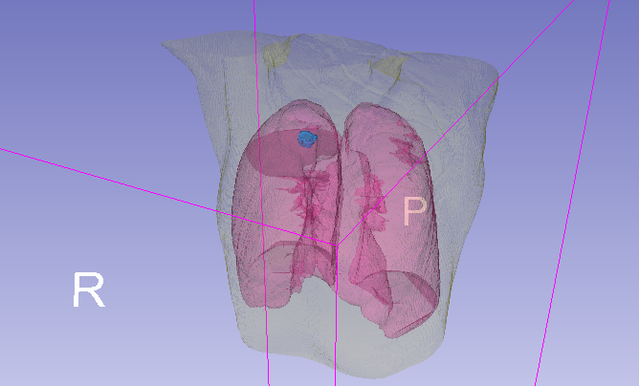
Scale Variations

Slide 6
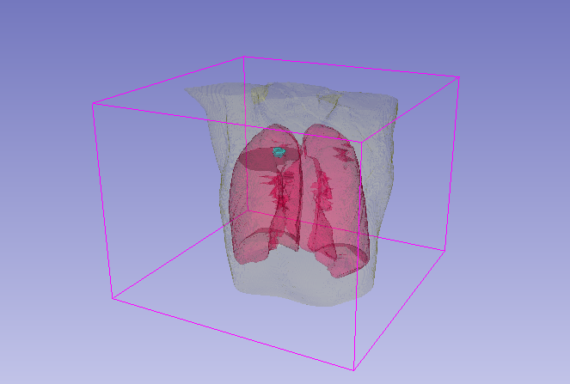
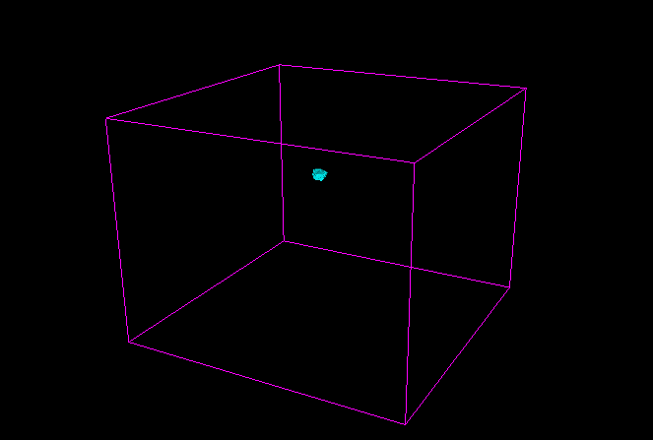
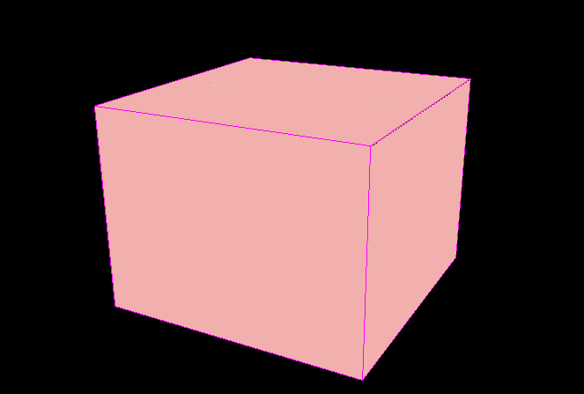
Data Imbalance
Data
Foreground
Background

Slide 7
F
B
1
:
1,162
Foreground
vs. Background

Slide 8
Position Variations
Scale Variations
Data Imbalance

Slide 9
Existing Strategies

Slide 10
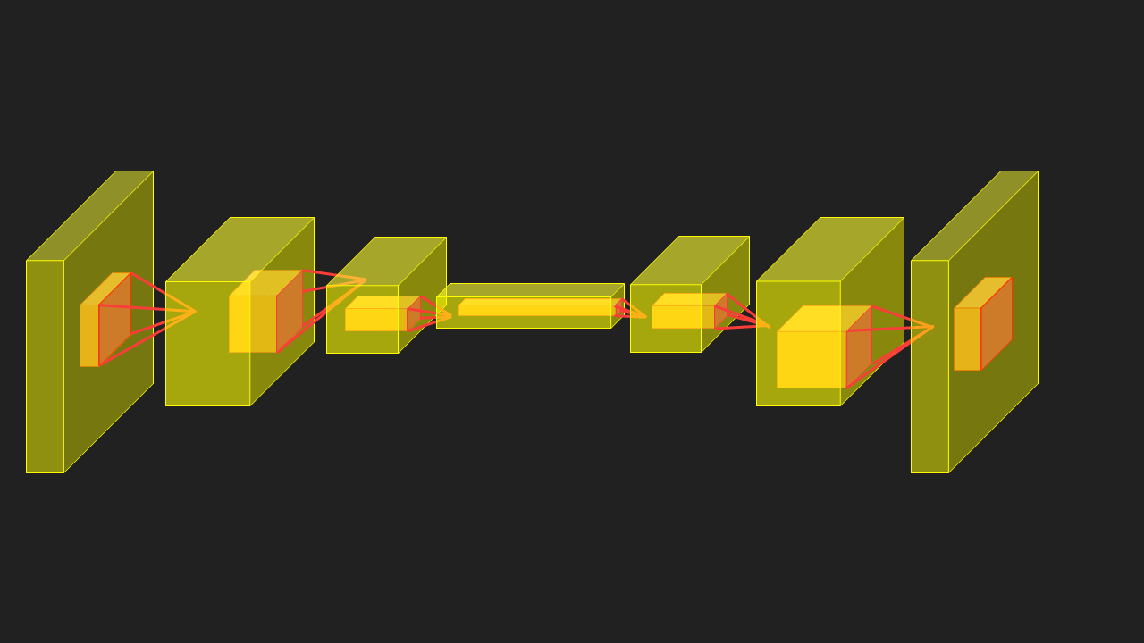
CNN for Position Variations
CNN
translation-equivariance
Segmentation
Algorithm
Segmentation
Algorithm
[1] http://kaiminghe.com/iccv17tutorial/maskrcnn_iccv2017_tutorial_kaiminghe.pdf

Slide 11
CNN for Scale Variations
CNN
scale-equivariance
Segmentation
Algorithm
Segmentation
Algorithm
[1] http://kaiminghe.com/iccv17tutorial/maskrcnn_iccv2017_tutorial_kaiminghe.pdf

Slide 12
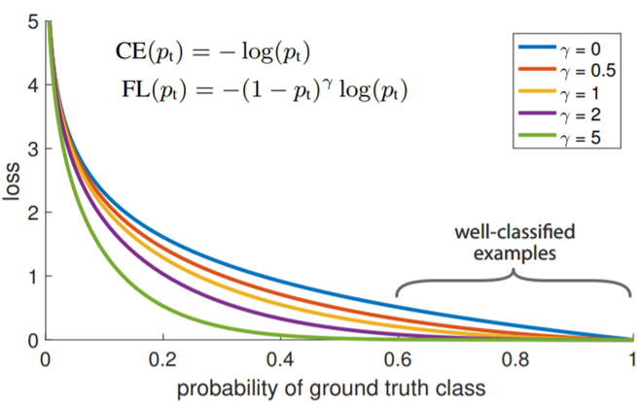
Focal Loss for Data Imbalance
down-weight
[2] Lin et al., “Focal Loss for Dense Object Detection”, TPAMI, 2018.

Slide 13
Naïve Approach

Slide 14
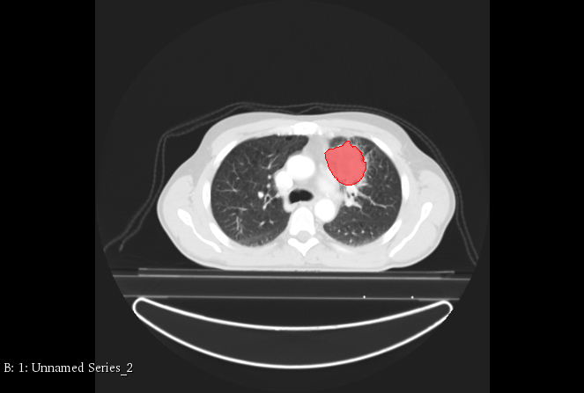
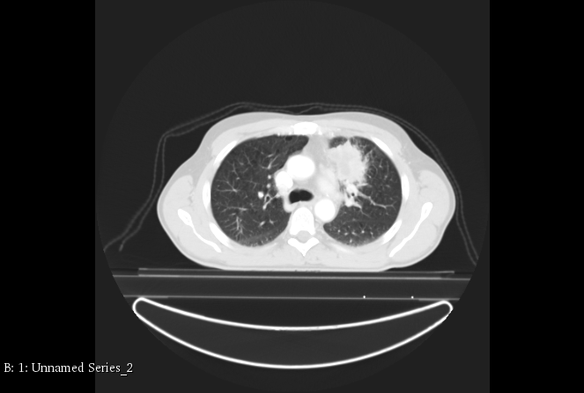
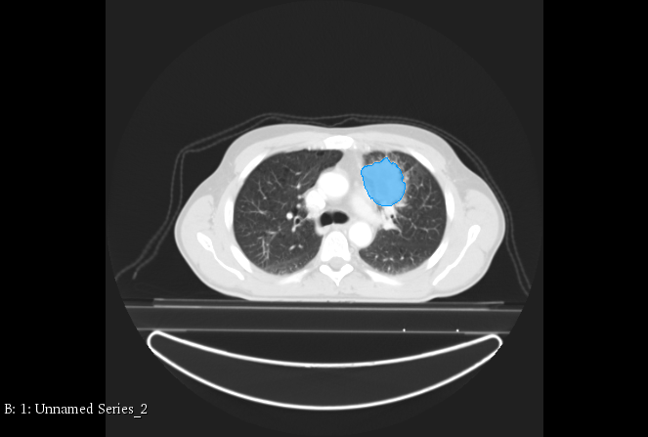
Data
Prediction
Ground
Truth
2D Segmentation
Network
Ignore interdependency between slices!
Loss

Slide 15
Our Proposal

Slide 16
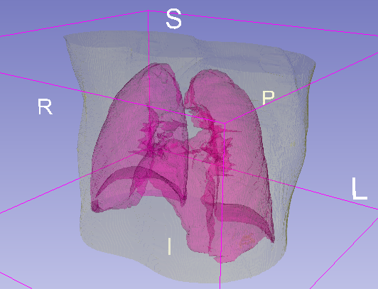
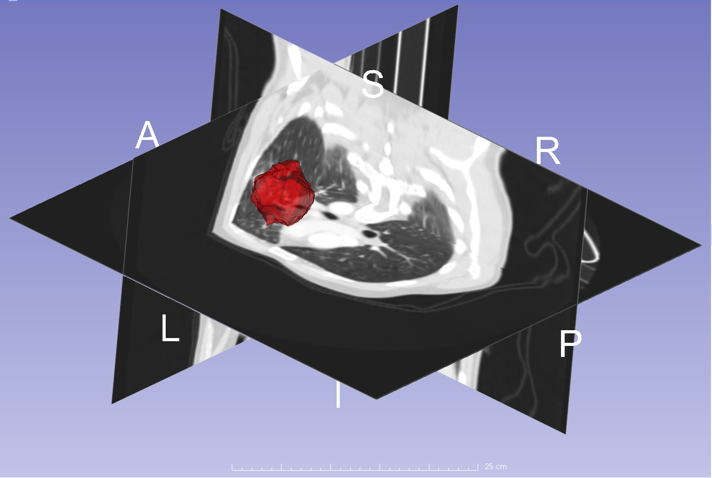
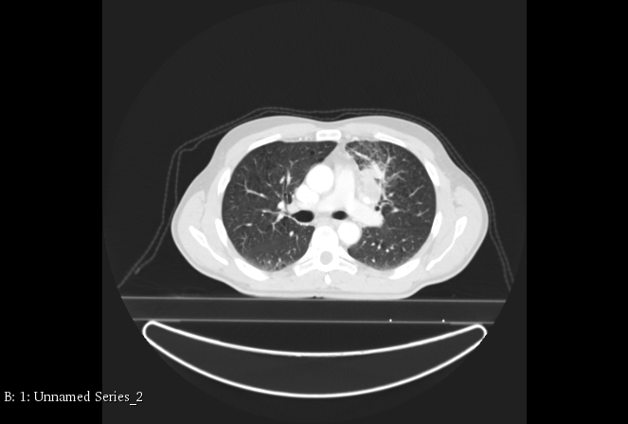
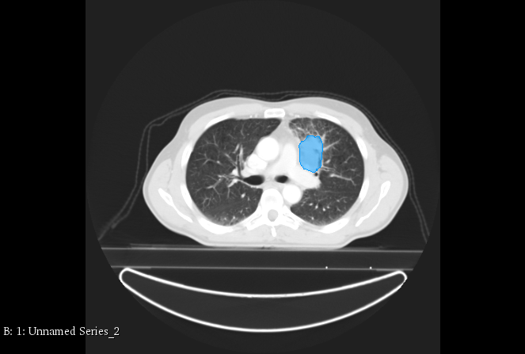
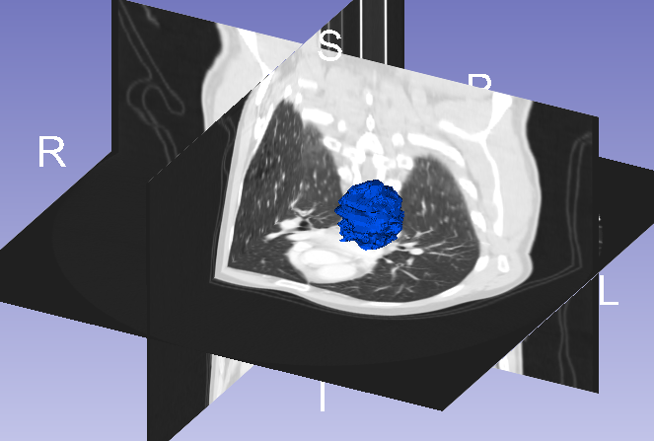
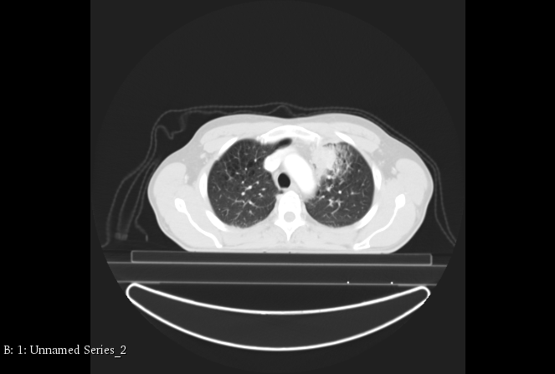
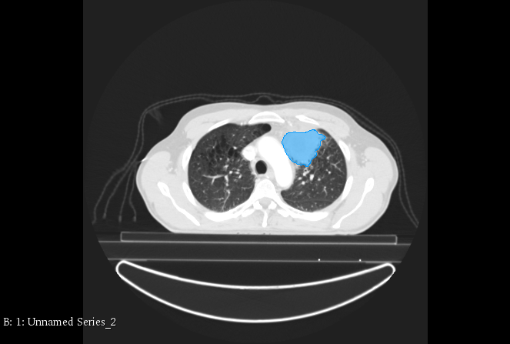
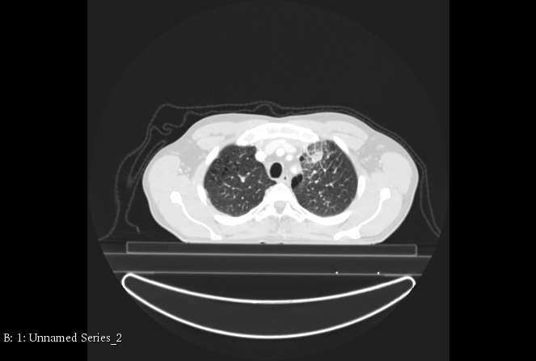
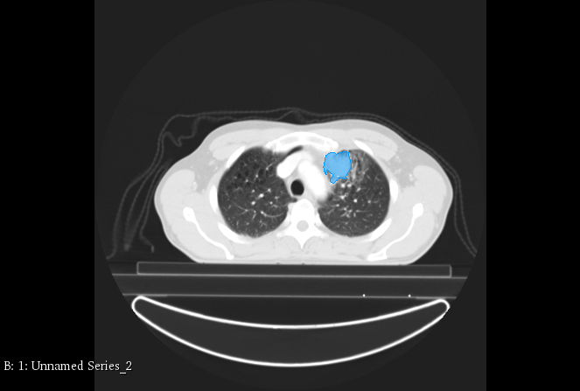
3D Data
3D Segmentation
Network
Stacking
Loss
2D Data
2D Ground Truth
3D Ground Truth

Slide 17
3D Segmentation
Network

Slide 18

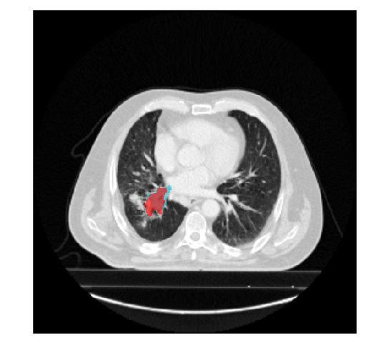
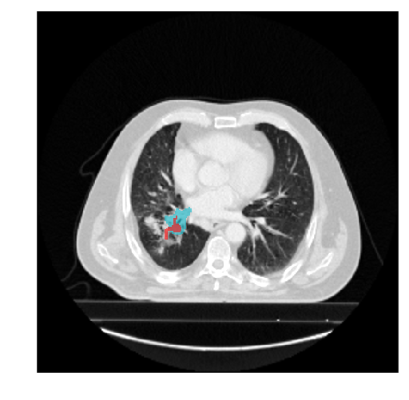
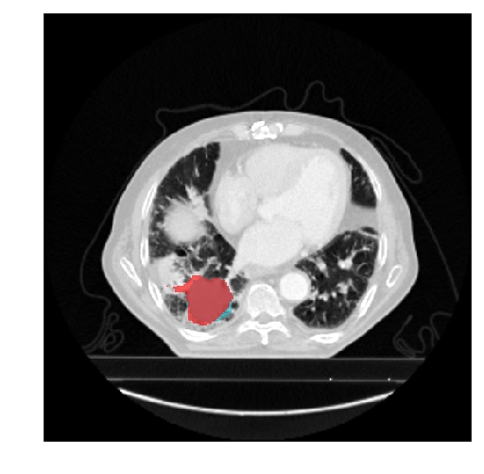
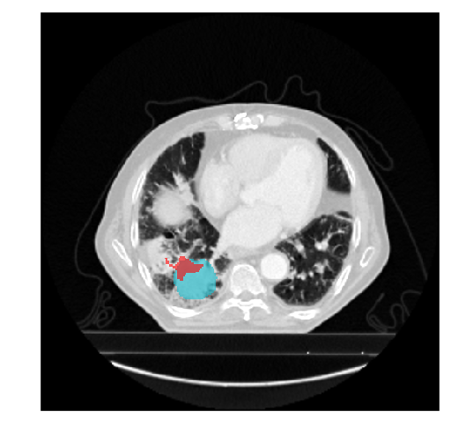
HighRes3DNet
HighRes3DNet [3]
3D U-Net [4]
[3] Li et al., “On the Compactness, Efficiency, and Representation of 3D Convolutional Networks: Brain Parcellation as a Pretext Task”, in IPMI, 2017.
[4] Çiçek et al.“3D U-Net: Learning Dense Volumetric Segmentation from Sparse Annotation”, in MICCAI, 2016.

Slide 19
Information Loss in Single Path
Single Path

Slide 20
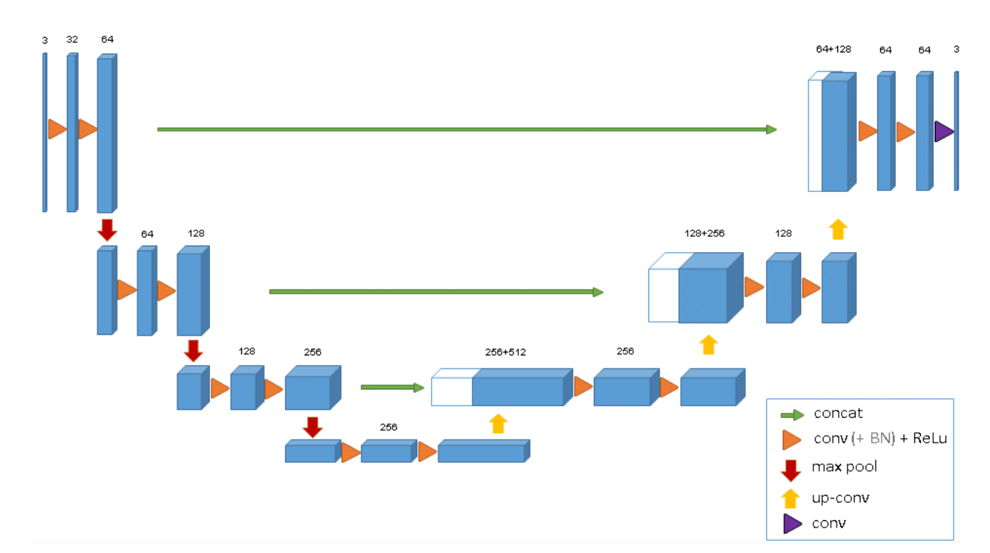
Skip Connections Prevent Information Loss
3D U-Net [4]
[4] Çiçek et al.“3D U-Net: Learning Dense Volumetric Segmentation from Sparse Annotation”, in MICCAI, 2016.

Slide 21
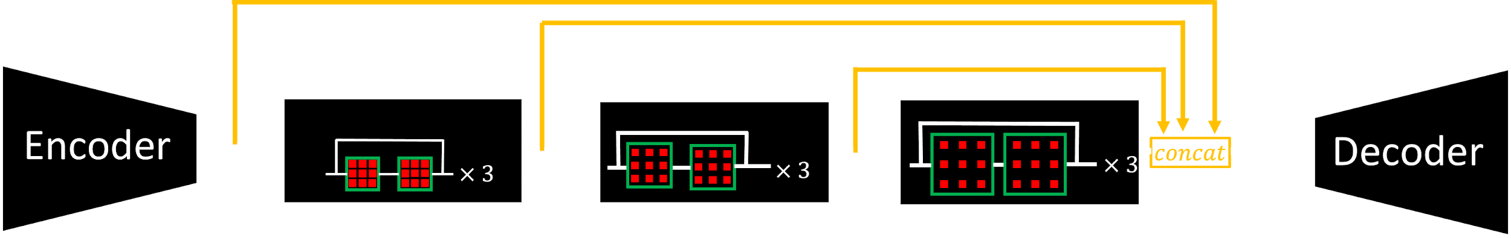
Notes:
Image after adding skip connection

Slide 22
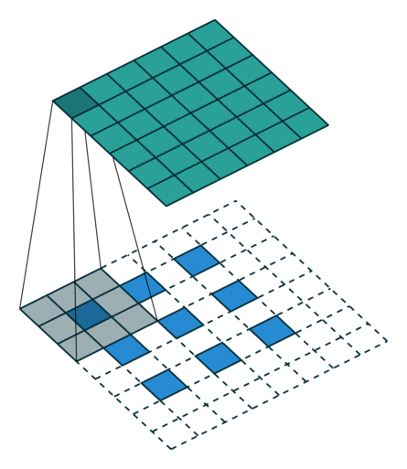
Information Loss in Deconvolution
Deconvolution
[5] https://github.com/vdumoulin/conv_arithmetic

Slide 23

Dense Up-sampling Convolution
Dimension: 2x2
Dimension: 4x4
Channel: 4
Channel: 1
[6] Wang et al., “Understanding Convolution for Semantic Segmentation”, arXiv, 2017.

Slide 24
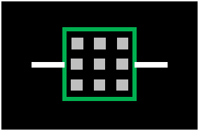

Stride : 2

Slide 25

Information Loss in Convolution
Stride 2 Convolution
[5] https://github.com/vdumoulin/conv_arithmetic

Slide 26

Dense Down-sampling Convolution
Dimension: 4x4
Dimension: 2x2
Channel: 1
Channel: 4

Slide 27
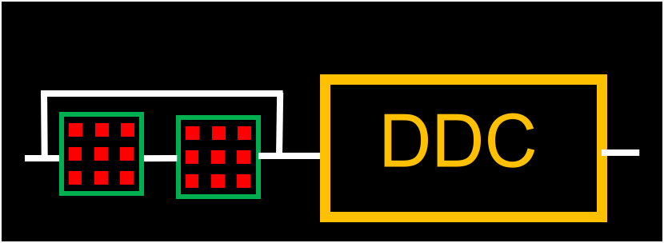
Stride : 2

Slide 28
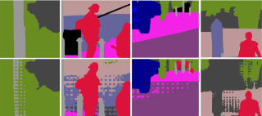
Gridding Effect
Gridding
Effect!
Ground Truth
Prediction w/o HDC
[6] Wang et al., “Understanding Convolution for Semantic Segmentation”, arXiv, 2017.

Slide 29
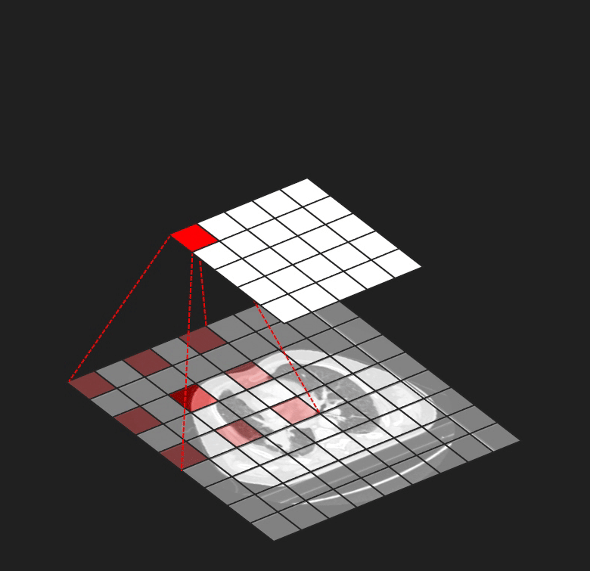
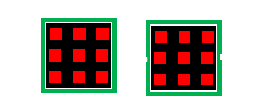
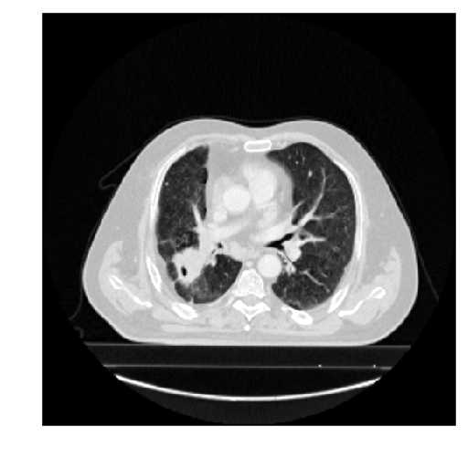
Gridding Effect
r=2
r=2
r : dilated rate

Slide 30
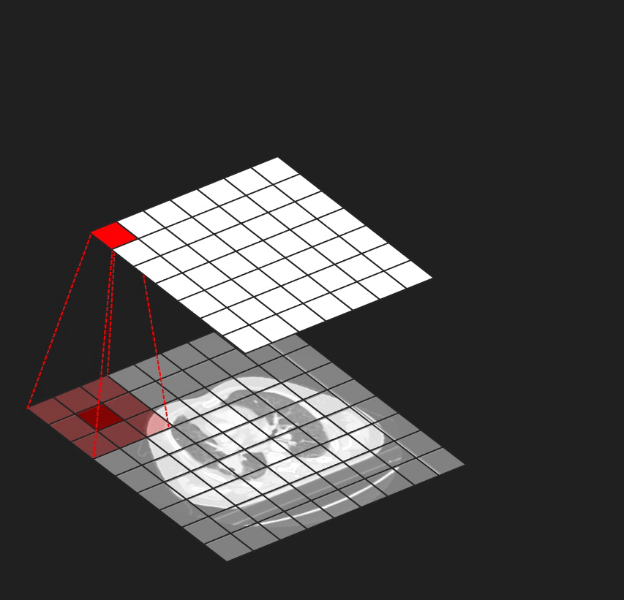
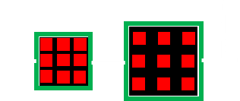
Hybrid Dilated Convolution
r=1
r=3
r : dilated rate

Slide 31
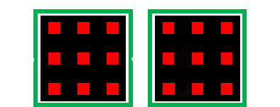
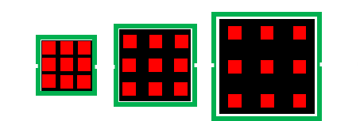
r=2
r=2
r=1
r=3
r=4
r=4
r=1
r=3
r=5
r : dilated rate

Slide 32

HighRes3DNet
Our Proposed Network
(HDC)
(HDC)

Slide 33
Evaluation

Slide 34
Performance
Model | Dice | Speed (iter/min)
3D U-Net [4] | 0.277 | 10
HighRes3DNet [3] | 0.467 | 15
Ours | 0.545 | 23
[3] Li et al., “On the Compactness, Efficiency, and Representation of 3D Convolutional Networks: Brain Parcellation as a Pretext Task”, in IPMI, 2017.
[4] Çiçek et al.“3D U-Net: Learning Dense Volumetric Segmentation from Sparse Annotation”, in MICCAI, 2016.

Slide 35
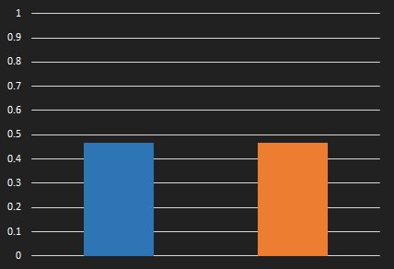
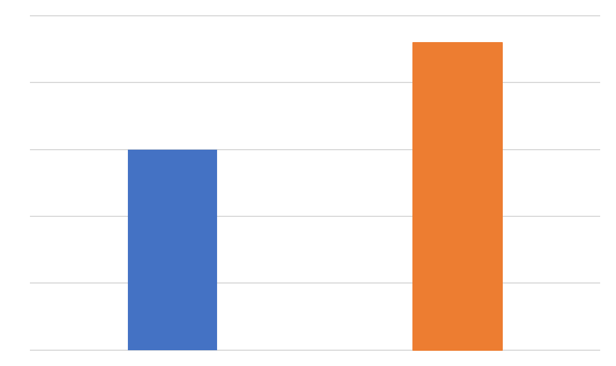
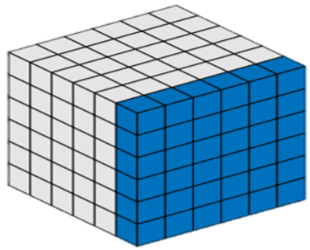
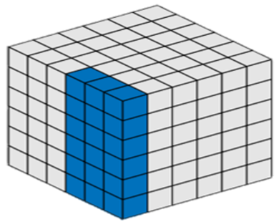
Group Normalization for Acceleration
Batch Normalization
Group Normalization
23
0.467
0.468
15
Dice
Speed (iter/min)
H, W
H, W
C
N
C
N
w/o GN
w/ GN
w/o GN
w/ GN
[7] Wu et al., “Group Normalization”, in ECCV, 2018.

Slide 36
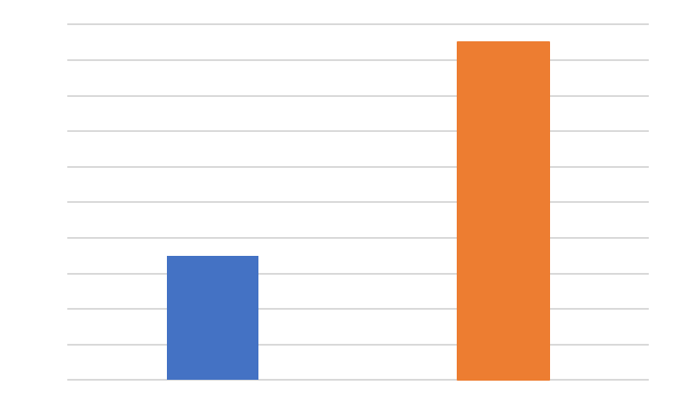
Focal Loss for Data Imbalance
0.545
Dice
0.533
w/o Focal loss
w/ Focal loss

Slide 37
Qualitative Results

Slide 38
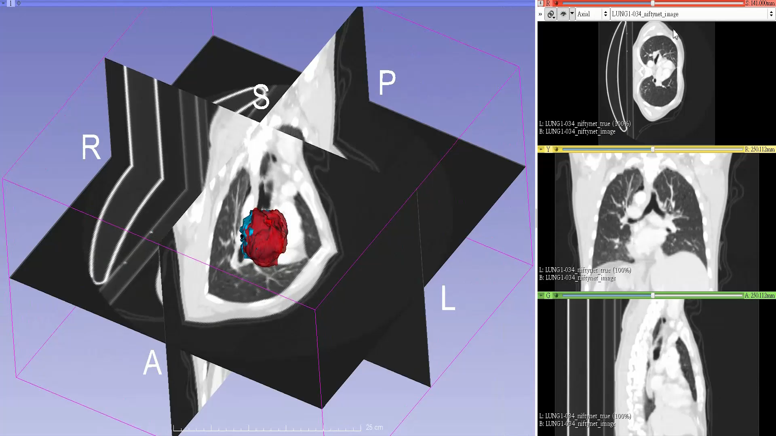

Slide 39
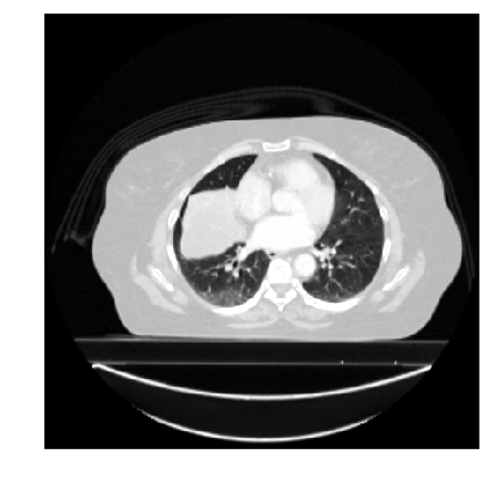
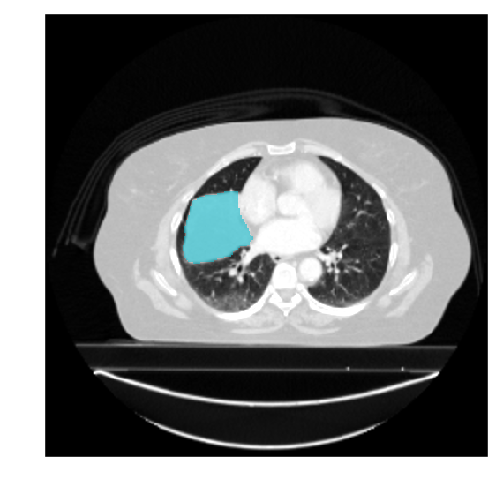
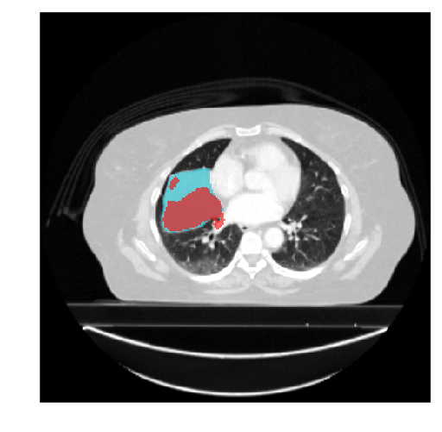




Patient 1
Patient 2
Input Image
GT
3D U-Net [4]
HighRes3DNet [3]
Ours
[3] Li et al., “On the Compactness, Efficiency, and Representation of 3D Convolutional Networks: Brain Parcellation as a Pretext Task”, in IPMI, 2017.
[4] Çiçek et al.“3D U-Net: Learning Dense Volumetric Segmentation from Sparse Annotation”, in MICCAI, 2016.

Slide 40
Conclusion

Slide 41

Accuracy
Efficiency
0.545
23
15
0.467
HighRes3DNet
Ours
HighRes3DNet
Ours

Slide 42

Brain Tumor Segmentation
[8] https://www.med.upenn.edu/sbia/brats2018/tasks.html

Slide 43

Coronary Plaque Segmentation
[9] Sun, Zhonghua., “Coronary CT Angiography in Coronary Artery Disease: Correlation between Virtual Intravascular Endoscopic Appearances and Left Bifurcation Angulation and Coronary Plaques”, in BioMed research international, 2013.

Slide 44



AI in Healthcare
AI System
Domain Experts

Slide 45
Thanks for listening!

Slide 46
Q & A

